Slide 1
Illinois Apprentice Network
June 4, 2019
A partnership with Aon and the Chicago Apprentice Network

Slide 2
Executive Order 2019-03
Directed DCEO to recommend how to improve industry targeting and align resources to serve disenfranchised populations
Convened education, workforce, and economic development partners to create a system-wide approach for addressing the requirements
Creates 3 action areas, with 10 strategies, and 37 proposed actions
Strengthens the State’s commitment to workforce development and job creation.
Submitted recommendations to Governor on 4.14.19 - Agenda for Workforce Development and Job Creation

Slide 3
Agenda for Workforce Development and Job Creation
Unite workforce development partners around regional cluster strategies
Identify high-impact regional clusters along with in-demand occupations and implement coordinated strategies that will strengthen workforce development throughout the state
Prepare Illinois workers for a career, not just their next job
Address barriers that prevent individuals from successfully completing training and employment
Connect job seekers with employers
Give employers easy access to the skilled workforce they need through shortened time from credential to employment and integrating work-based learning into more opportunities for job seekers

Slide 4
Illinois’ Apprenticeship Priorities
The Illinois Workforce Innovation Board’s (IWIB) Apprenticeship Committee
Fully integrate apprenticeship into state workforce development, education, and economic development strategies and programs;
Support the rapid development of new registered apprenticeship programs and/or the significant expansion of existing registered programs;
Support the development and recruitment of a diverse pipeline of apprentices; and/or
Build state capacity to make it easier for industry to start registered apprenticeship programs and for apprentices to access opportunities.

Slide 5
Moving Forward
May – December 2019 - Conduct webinars to introduce and educate workforce development and education professionals on how to support employers and apprentices to successfully expand apprenticeship
July 2019 – Conduct In-Person, Regional Discussions with Employers
2019 -2020 – Launch/support Regional Apprenticeship Partnerships in local areas to include employers, training providers, educators, workforce professionals, LWIAs, unions, and supportive service providers. Below are possible ways to participate:

Slide 6
Agenda
Aon Apprenticeship Program Overview
Recruitment Process & Timeline
Chicago Apprentice Network
Apprenticeship 2020 (A2020)
Q&A

Slide 7
Aon Apprenticeship Program Overview

Slide 8
Apprenticeships: Why Aon is investing now
Aon’s Apprenticeship program signifies the evolution of our talent strategy:
We are diversifying our Talent strategy and connecting with a wider pool of prospective colleagues earlier in their career.
We cultivate future talent through on-the-job training and development that is specific to our talent needs.
We develop a talent pipeline for roles that don’t necessarily require a four-year bachelor’s degree.
In the UK, we’ve seen retention for former apprentices at a higher rate than Aon’s average retention rate for similar roles, which were filled by non apprentices. This engagement to organization can be attributed to the unique investment relationship between Aon and the apprentice.

Slide 9
Program details
Two Year Program
Guaranteed position at Aon at the conclusion of the program
Full-time Compensation (40 hours/week)
28-32 hours at Aon per week
8-12 hours of class per week
Full Employee Benefits
Paid Tuition Benefit in pursuance of Associate’s Degree
Either at Harold Washington College or Harper College
Business degree with track-specific classes (Insurance, HR, or Technology)
Department of Labors Certified Insurance Apprentice status
Two Year program
Full-time compensation
On-the-job training
Paid tuition
Manager & Mentor
Full Employee Benefits

Slide 10
Programmatic Elements
Weekly one-on-one meetings with Program Coordinator from One Million Degrees
Dedicated track champion & monthly meetings
One Aon-led development session per month
Dedicated 2-day Orientation session
Academic counselor & tutors available through colleges
Exposure to internal and external leaders

Slide 11
Recruitment Overview & Timeline

Slide 12
What we look for in candidates
This role is ideal for candidates looking for their first role in a corporate setting.
Education
High School Diploma
Experience
Strong verbal / communication skills
True understanding of customer service
Intermediate computer skills, including experience with MS Office Software
Ability to work in a fast-paced , team environment
Attention to detail & problem solving skills
Enrolled at HWC or Harper by beginning of program in 2018
Fast learner

Slide 13
2018 Recruitment Process
Apprentices apply online beginning August 2018
First Round Assessment
Complete Digital Interview with Aon
Confirm College Readiness with HWC or Harper Admissions
Final Round Interviews in October and November 2018
In person interviews at Aon Center or Lincolnshire offices
Background check required, regardless of business unit
Offers Extended in December 2018
Begin at Aon
Orientation: January 2019

Slide 15
Chicago Apprentice Network- Vision, Goals
The goal of the Chicago Apprentice Network is to build awareness and excitement around apprentice programs, then work with companies to help build similar programs within their organizations by:
Leveraging a “how to” playbook.
Quarterly networking events
Sharing best practices
Industry examples.
Since the launch of the Chicago Apprentice Network in August 2017, we have 25 companies and 435 apprentice roles committed to, with a goal of creating 1,000 apprentice opportunities by the end 2020

Slide 16
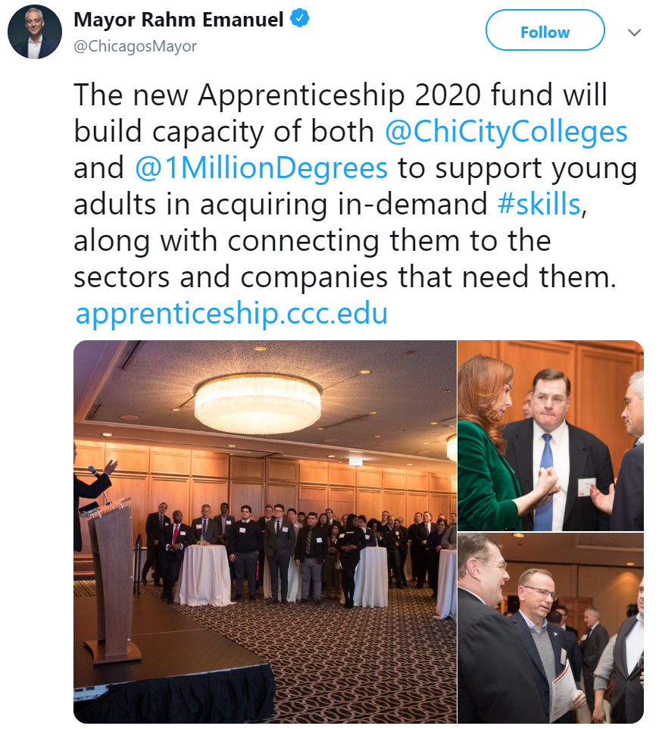
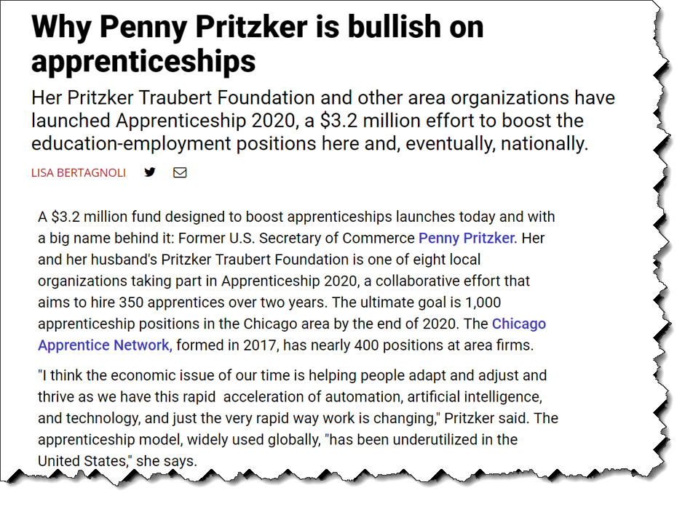
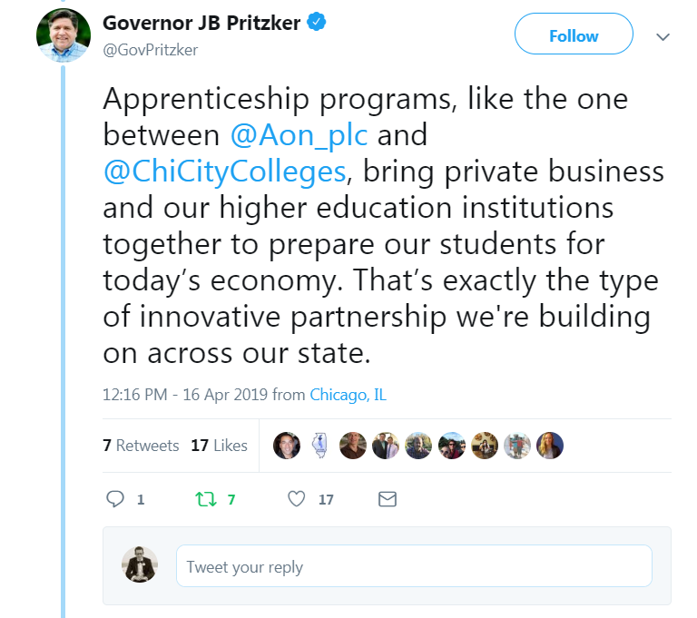
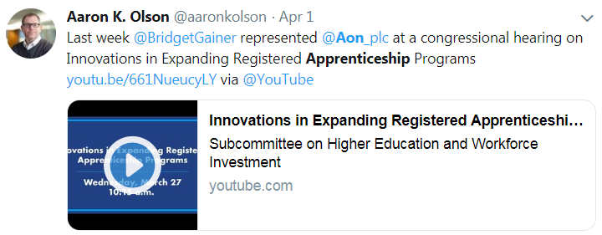
Chicago Apprentice Network- Momentum
Twitter: Jan 2019
Crain’s: Jan 2019

Slide 17
Chicago Apprentice Network- Playbook
Business Round Table: Jan 2019

Slide 18
Chicago Apprentice Network - How it Works
3. If no, leverage a non profit partners
4. Skills to help design apprentice program & coordinate with College
?
5. If yes, connect to Comm. College to help design apprentice program
2. When employer is ready to commit / build apprentice program, do they have HR capacity in house?
8. Employers join CAN and bolsters recruiting of other employers
1. CAN builds awareness / excitement around apprentice programs thru meetings, quarterly events, playbook, etc.
6. Recruit students to Apprentice Programs
Employers
7. Connect Students to Employers to launch apprentice programs
Students

